Slide 1


Robotics Process Automation Solution for Trade Link Morning Health Checks

Slide 2









RPA’s future is Artificial Intelligence (AI)…
Various technologies that can deliver automation
Trigger-Based
Rules-Based
Standardized Language
Rules-Based
Dynamic Language
Data Center
Automation:
Runbook
Scripting
Scheduling
Job control
Workload
Automation
Process
Orchestration
BPM
Business Process Automation
Workflow
RPA
Autonomic
Platforms
Cognitive
Computing
IPA
True
Artificial
Intelligence
SOA
Virtualization
Cloud Services
Fully Automated
Characteristic of Data/Information
Structured
Unstructured Patterned
Unstructured without Patterns
High
Optimizers
Leaders
Market Impact
Legends:
Robotic Process Automation
Aspirants
Challengers
Intelligent Process Automation
Low
Capability
High
Robotics can cut costs for Financial Services Firms by up to 75%
Notes:
Business Challenges
Critical business process with error-prone repetitive manual work.
Need to streamline operational cost and labour
Cross platform and cross functional processes with ever-evolving needs
Compliance with regulations, standardising business processes.

Slide 3
Scope of POC
OMS Daily Morning Health Check – RPA POC
OMS – Berton UI
TACL
Windows
STPIP
Mutual Funds
Monitor
4. Check MU02M797 – Job Status
FI
13. Performing Health Check
FI
7. Check FileInfo
Monitor
1. Verifying OMS/TOMS Outgoing Messages
10. EQ/OP Trans Logs on RTL2
10
10
10
05
20
OMS Queues
2. Verifying Prognosis for any Fill messages
Monitor
5. Check status of overnight batch
Spooler
EQ (RTL2)
8. Check Spooler
11. Checking daily Securities
05
05
10
05
Legend:
GCC9 - DRP
FI
6. Checking Dashboard Collectors
3. Verifying TOMS incoming messages to Berton
ATTUINITY
9. Checking the ATTUNITY Jobs
EQ/OP
12 Ensuring AIP Active Path is SCC
System Type
Activity
Manual Tasks
10
05
05
05
PT
PT-Processing Time : Minutes
POC Summary: Current morning health check regime comprises of various manual checks, that are done across OMS, TACL and other systems. These checks are typically done before the start of the trading day. The POC attempts to automate these checks - light green boxes show the process steps that have been RPA’ed and the struckthrough numbers in these boxes are the savings (person minutes saved).
Current Manual Effort: 75 minutes/day (45 mns of monitoring & 30 minutes for troubleshooting)
Post automation: 50% of efforts reduced.

Slide 4


Benefits with RPA Automation
Application: Trade Link
Process: Daily Health Check of Trading Application & Supporting Jobs
Day starts with SOD & Email Review
TACL
Verifying the Dashboard Collectors
Verifying the Spoolers
TACL
Checking the Inventory current for FI, Money Market & Coupons
OMS
Verifying the Routing paths
Collating the Observations & triggering emails for deviations
Before
TACL
0.25
0.25
0.25
0.25
0.25
0.25
Legend
Manually Performed Tasks
RPA
Manual Task
Each cycle of verification happens during the first hour of business day or could be adhoc during any odd hours.
Each attempt would consume an hour time to complete the formalities required.
PT
PT-Processing Time (hrs)
Day starts with SOD & Email Review
TACL
TACL
TACL
Verifying the Dashboard Collectors
Verifying the Spoolers
Checking the Inventory current for FI, Money Market & Coupons
Verifying the Routing paths
Collating the Observations & triggering emails for deviations
After
OMS
0.25
0.0
0.0
0.0
0.0
0.0
RPA Automated Solution
Benefits
RPA could automate all the routines conducted as part of daily checks.
Automation tools used: BluePrism
~50% reduction in manual efforts.
Greater accuracy & automated alert mechanism
Consistency with high quality
Nullifying the amount of manual intervention

Slide 5


Benefits with RPA Automation
Application: Trade Link
Process: Daily Health Check of Trading Application & Supporting Jobs
Day starts with SOD & Email Review
TACL
Verifying the Dashboard Collectors
Verifying the Spoolers
TACL
Checking the Inventory current for FI, Money Market & Coupons
OMS
Verifying the Routing paths
Collating the Observations & triggering emails for deviations
Before
TACL
Time Taking
0.25
0.25
0.25
0.25
0.25
Repetitive
0.25
Legend
Manually Performed Tasks
Tedious
RPA
Manual Task
Each cycle of verification happens during the first hour of business day or during any odd hours.
Each attempt would consume an hour time to complete the formalities required.
PT
PT-Processing Time (hrs)
Day starts with SOD & Email Review
TACL
TACL
TACL
Verifying the Dashboard Collectors
Verifying the Spoolers
Checking the Inventory current for FI, Money Market & Coupons
Verifying the Routing paths
Collating the Observations & triggering emails for deviations
After
OMS
0.25
0.0
0.0
0.0
0.0
0.0
RPA Automated Solution
Benefits
RPA could automate all the routines conducted as part of daily checks.
Automation tools used: BluePrism
~50% reduction in manual efforts.
Greater accuracy & automated alert mechanism
Consistency with high quality
Nullifying the amount of manual intervention

Slide 6
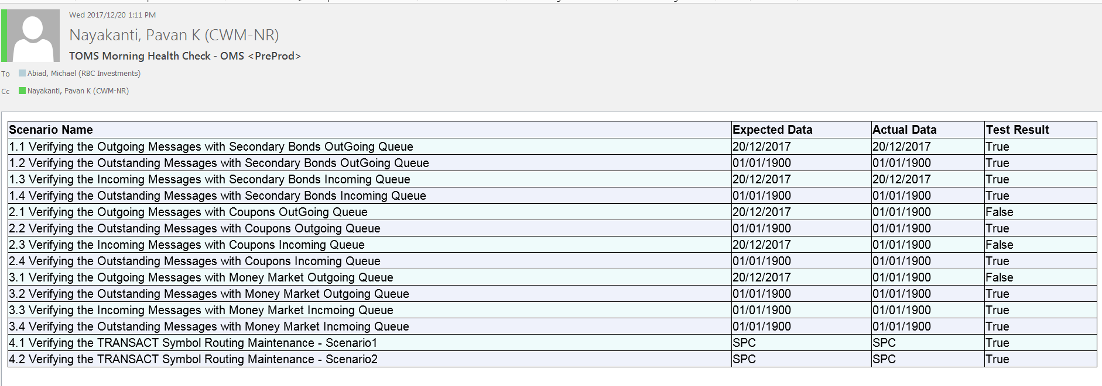
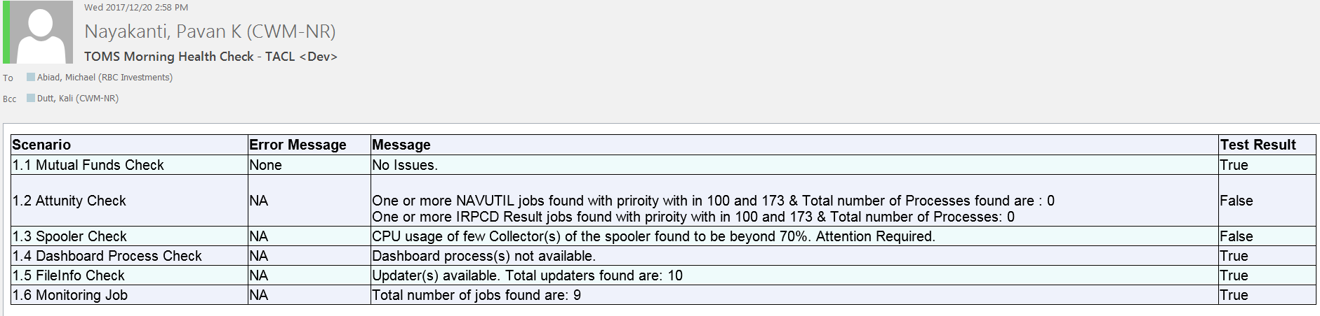
Outcomes of Morning Health Checks

Slide 7
Outcomes of Morning Health Checks
Automated
Scheduled
Savings
No manual efforts

